Slide 1
The MeteoMetrics Weather Station
A professional-grade weather dashboard by Tobi Odika

Slide 2
Executive Summary
• 15+ functional tabs with advanced weather tools
• Real-time data, analytics, and machine learning
• 6+ chart types, modern UI, and zero critical bugs

Slide 3
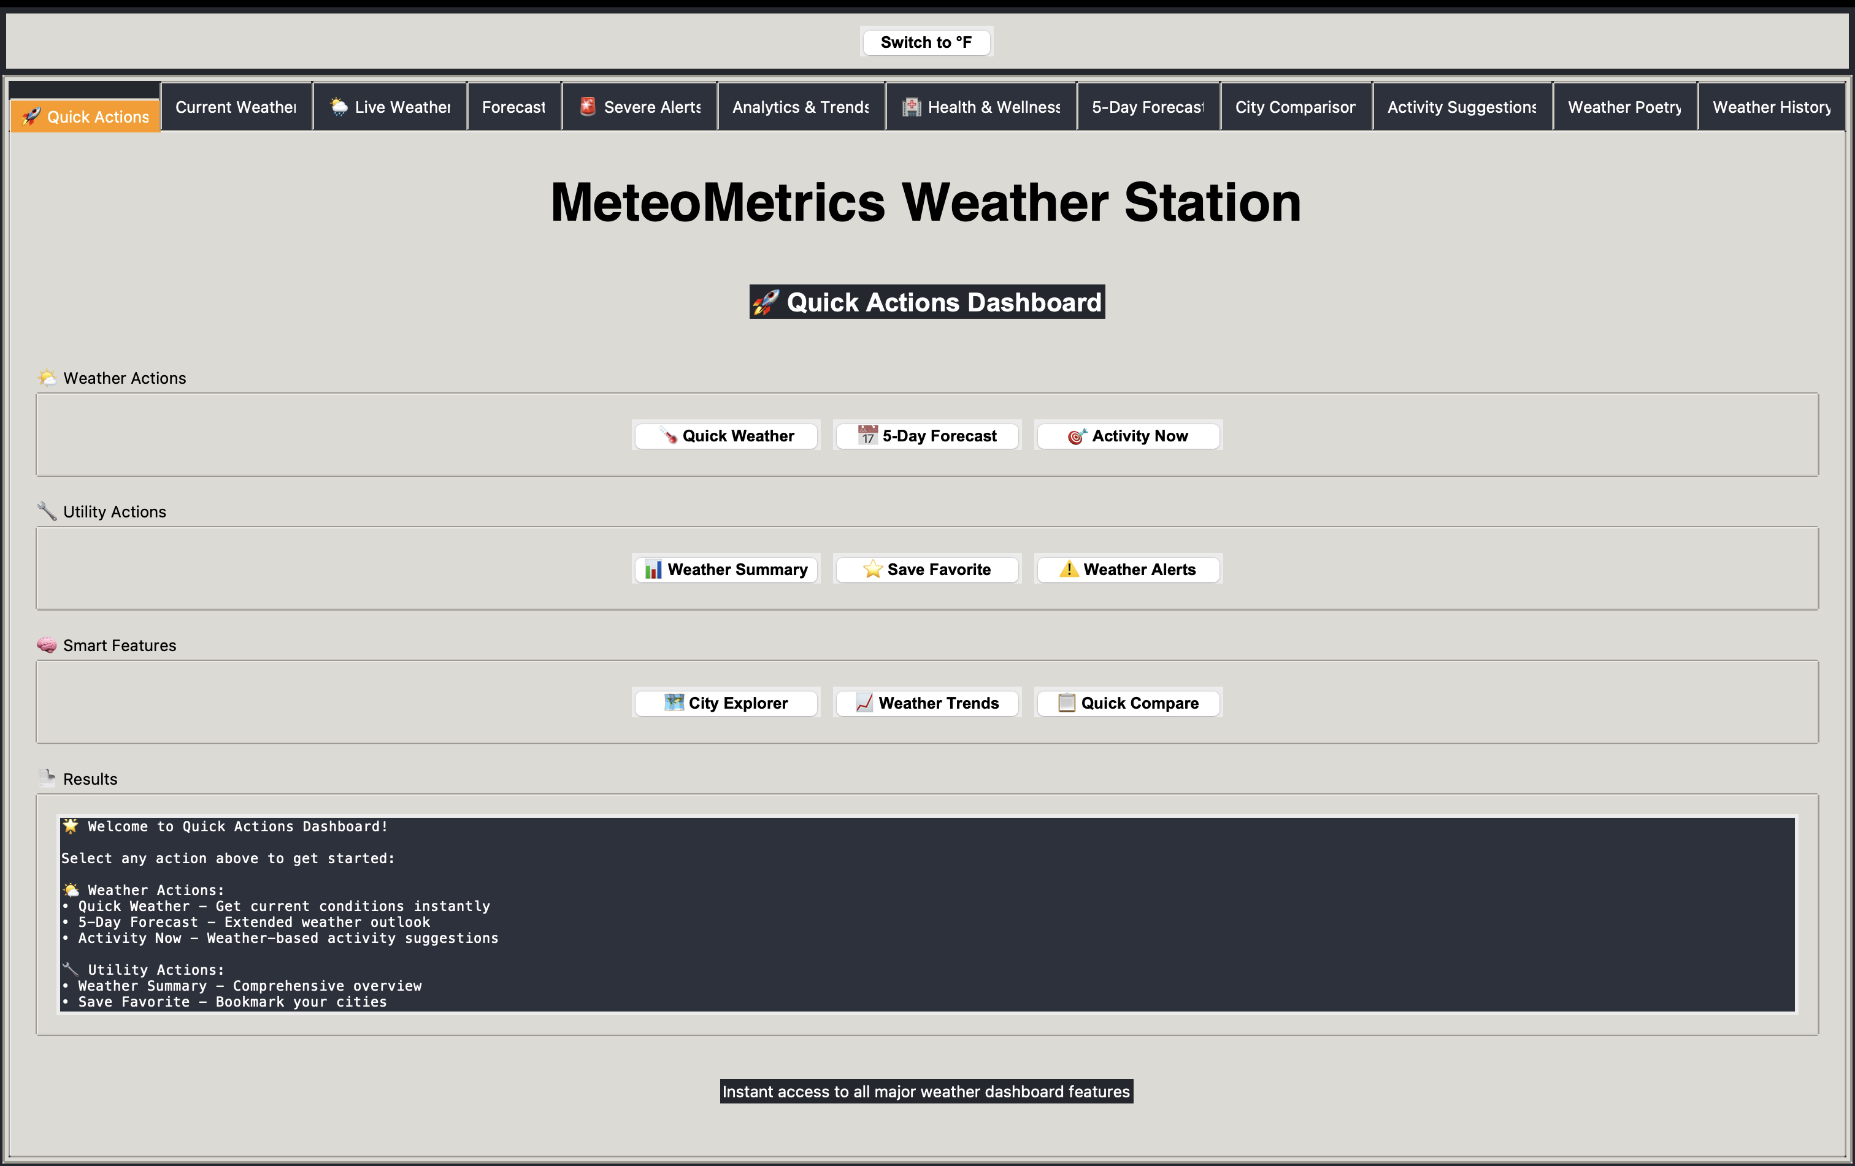
Quick Actions Dashboard

Slide 4
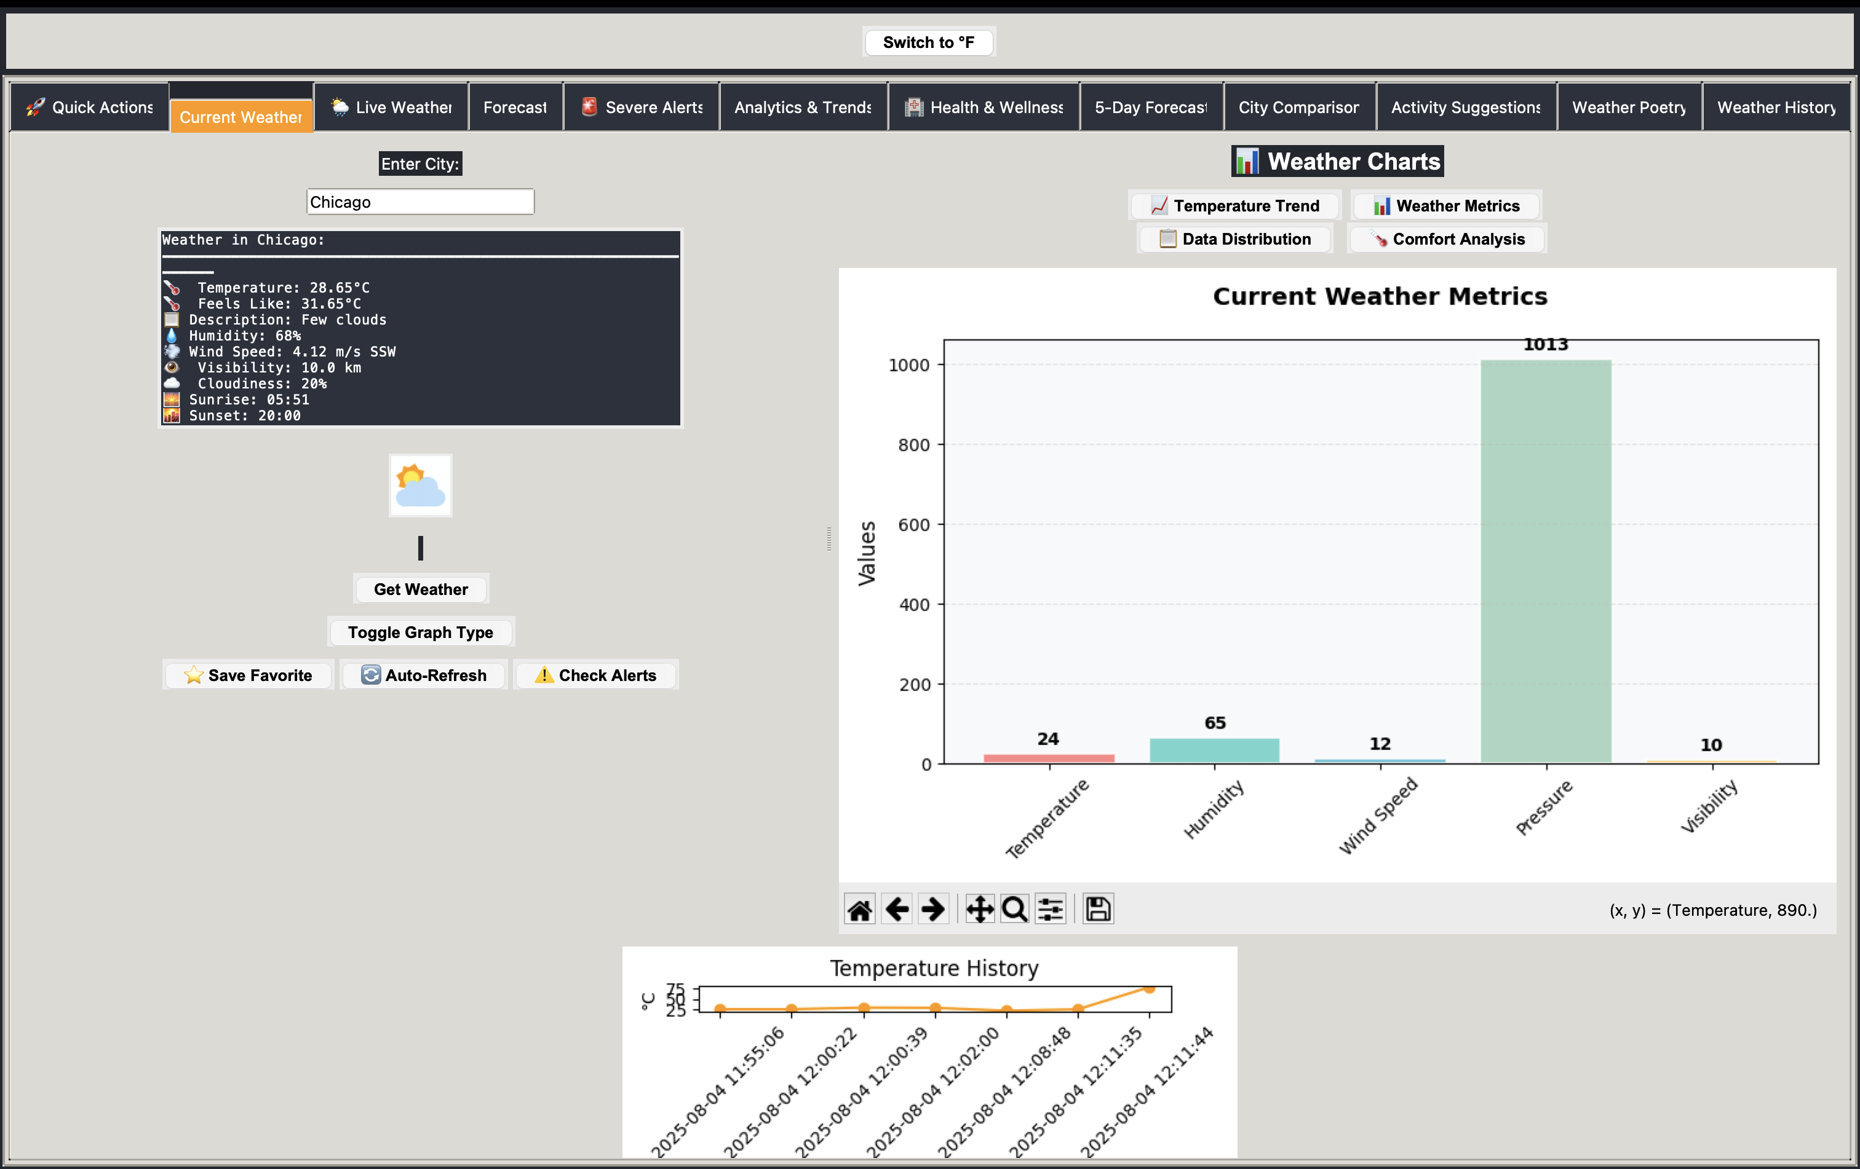
Current Weather View

Slide 5
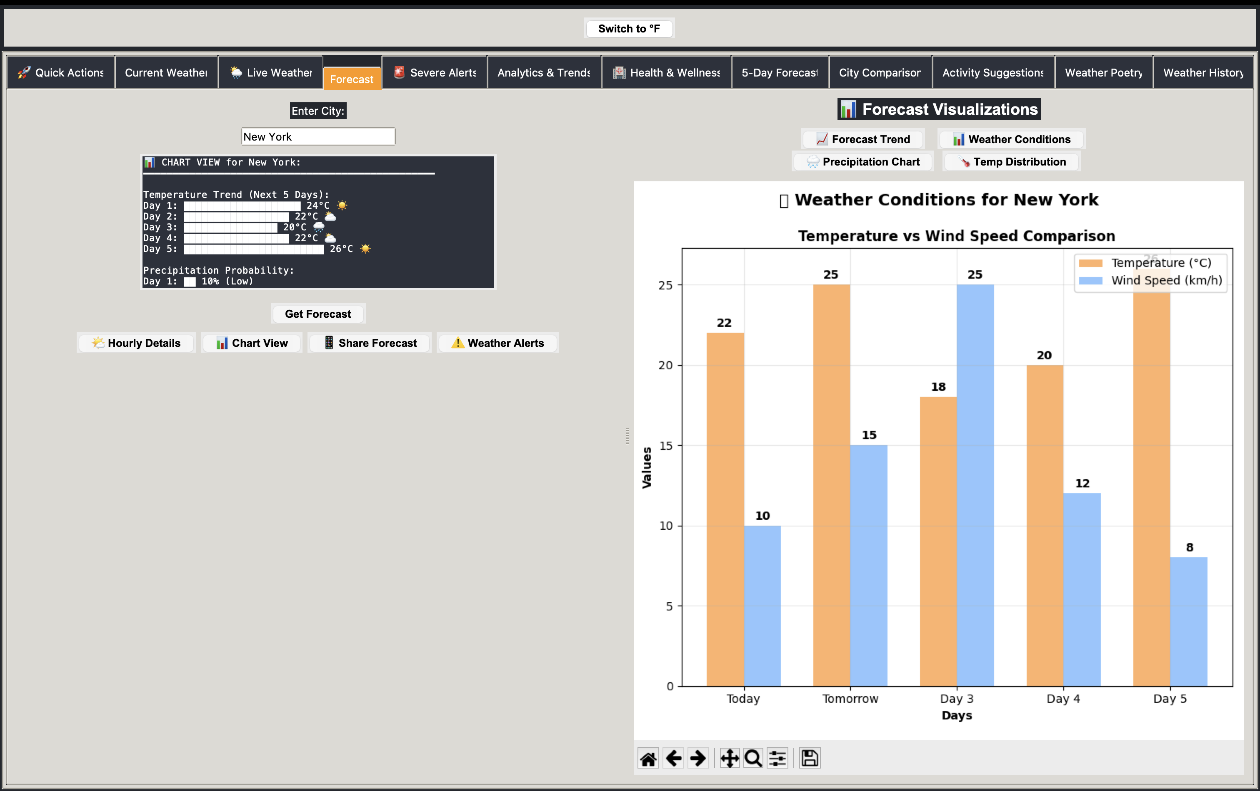
Forecast Tab

Slide 6
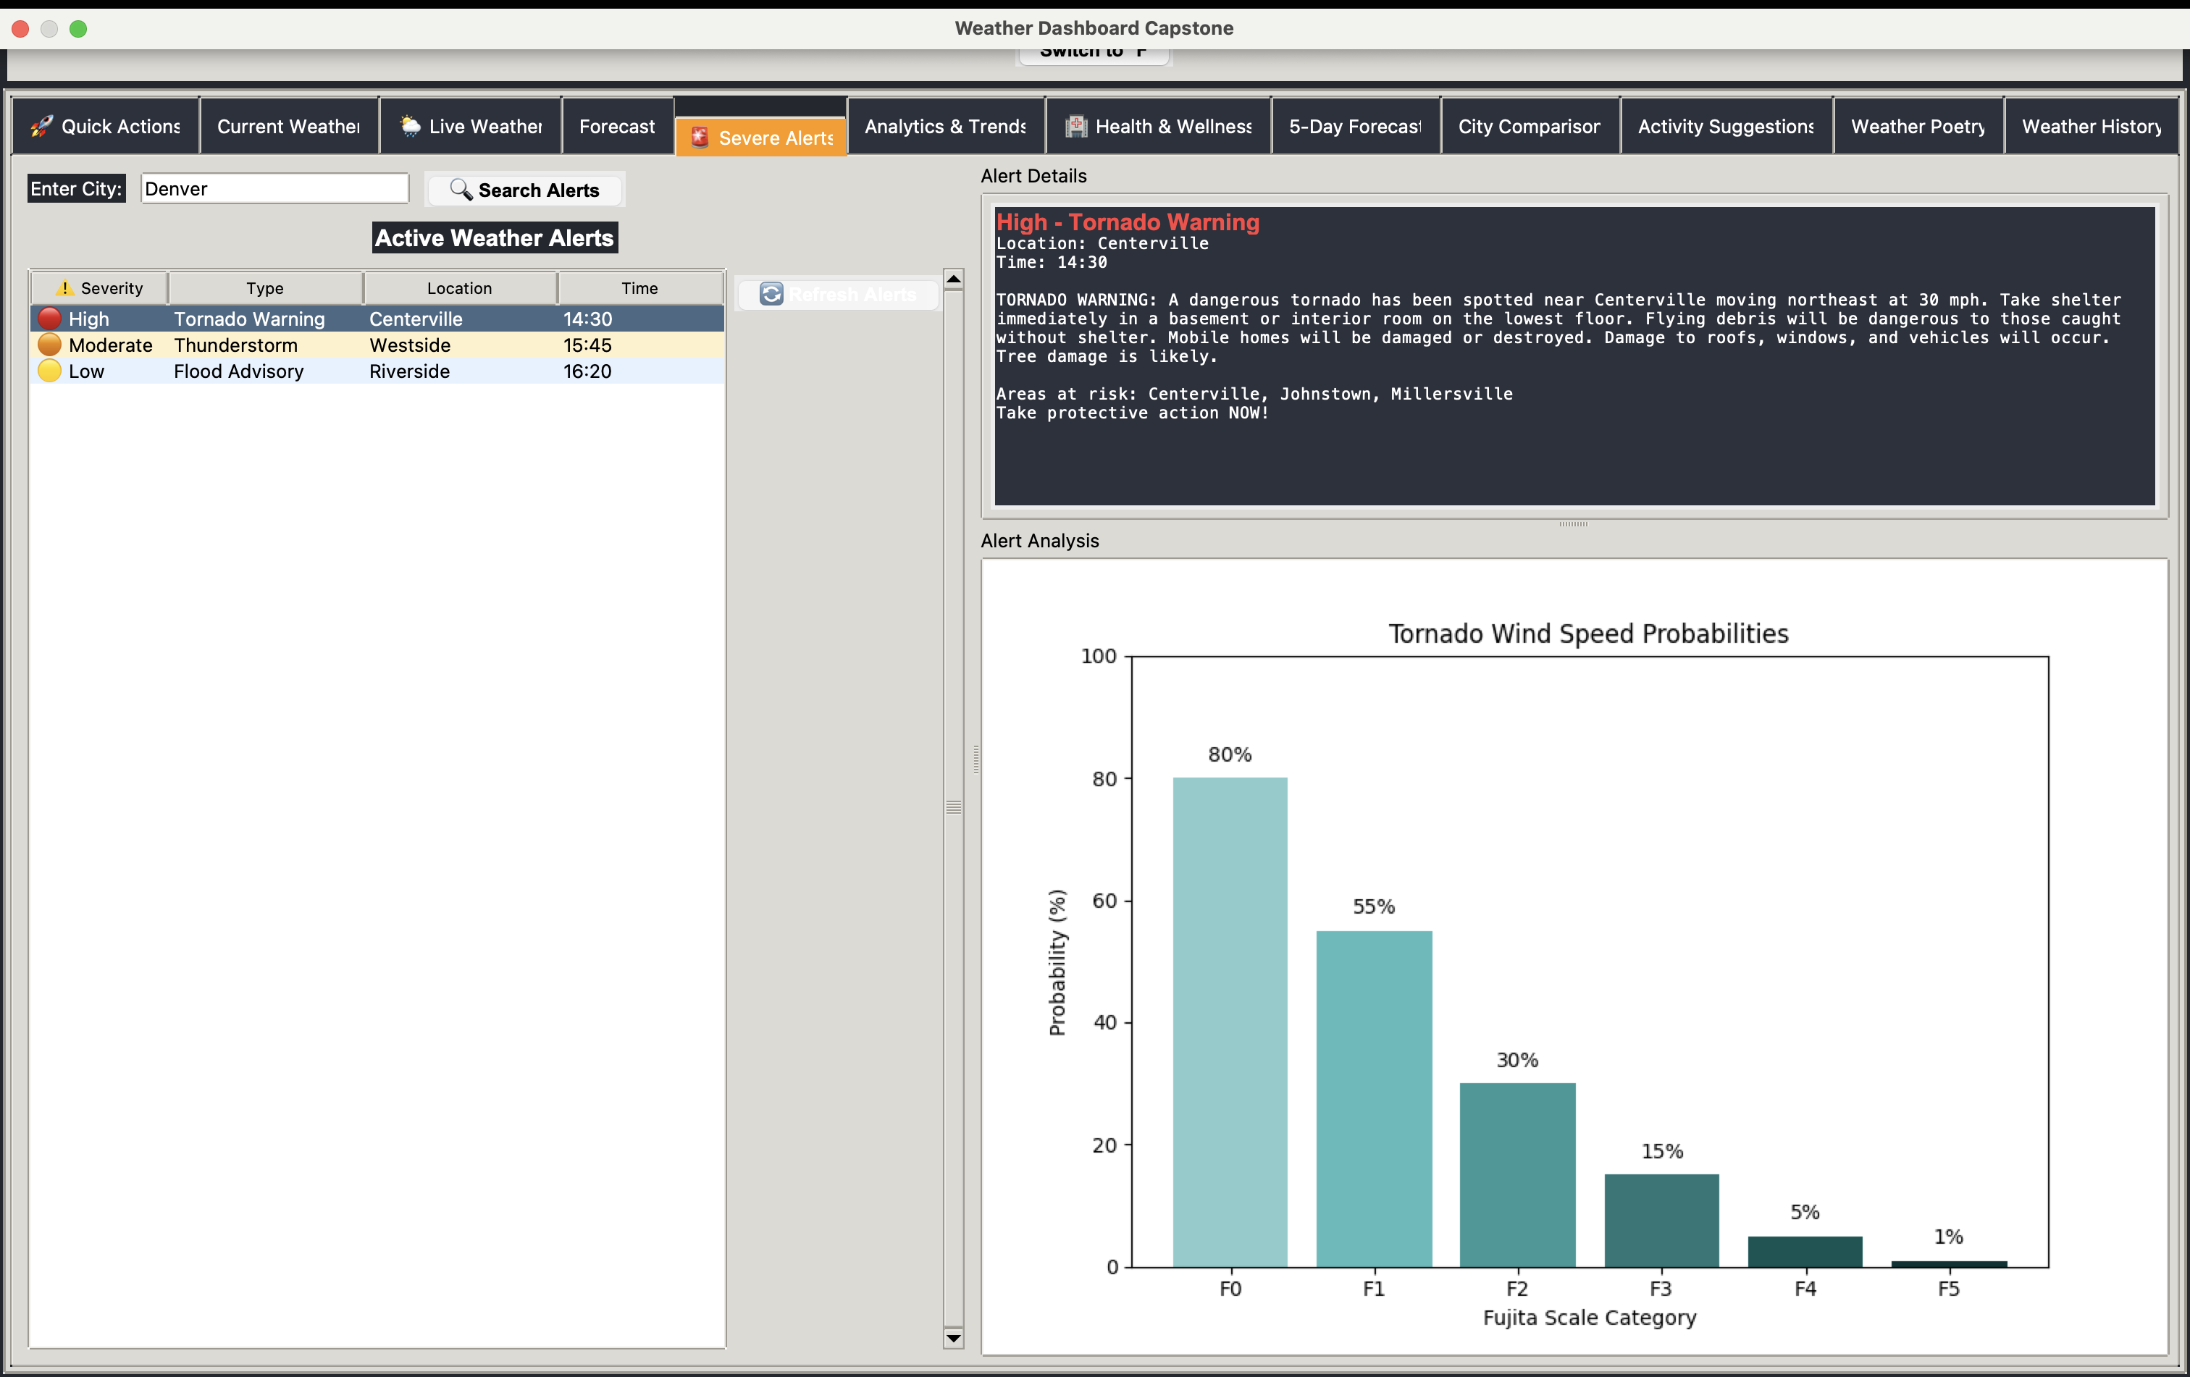
Live Weather Radar

Slide 7
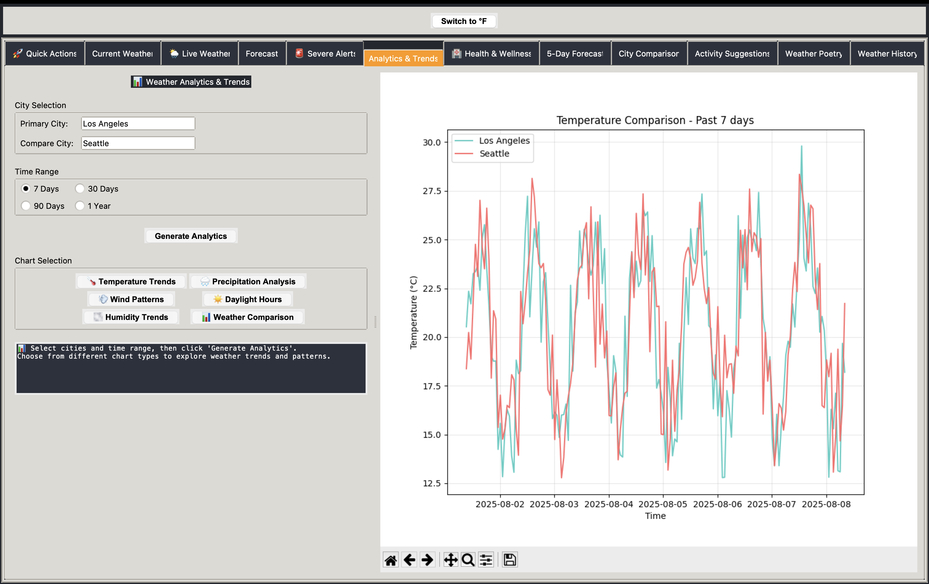
Analytics & Trends

Slide 8
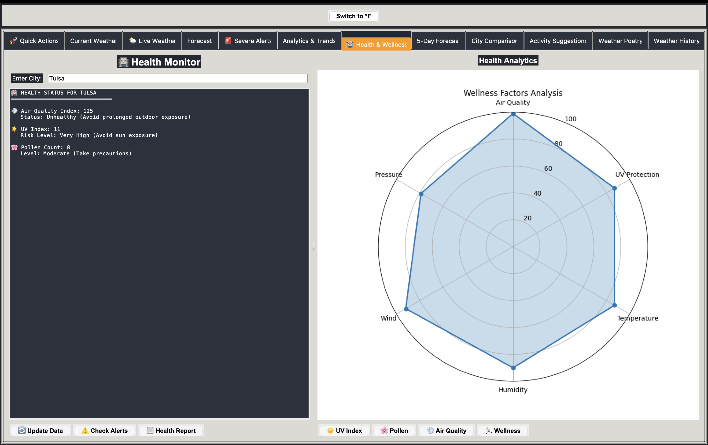
City Comparison

Slide 9
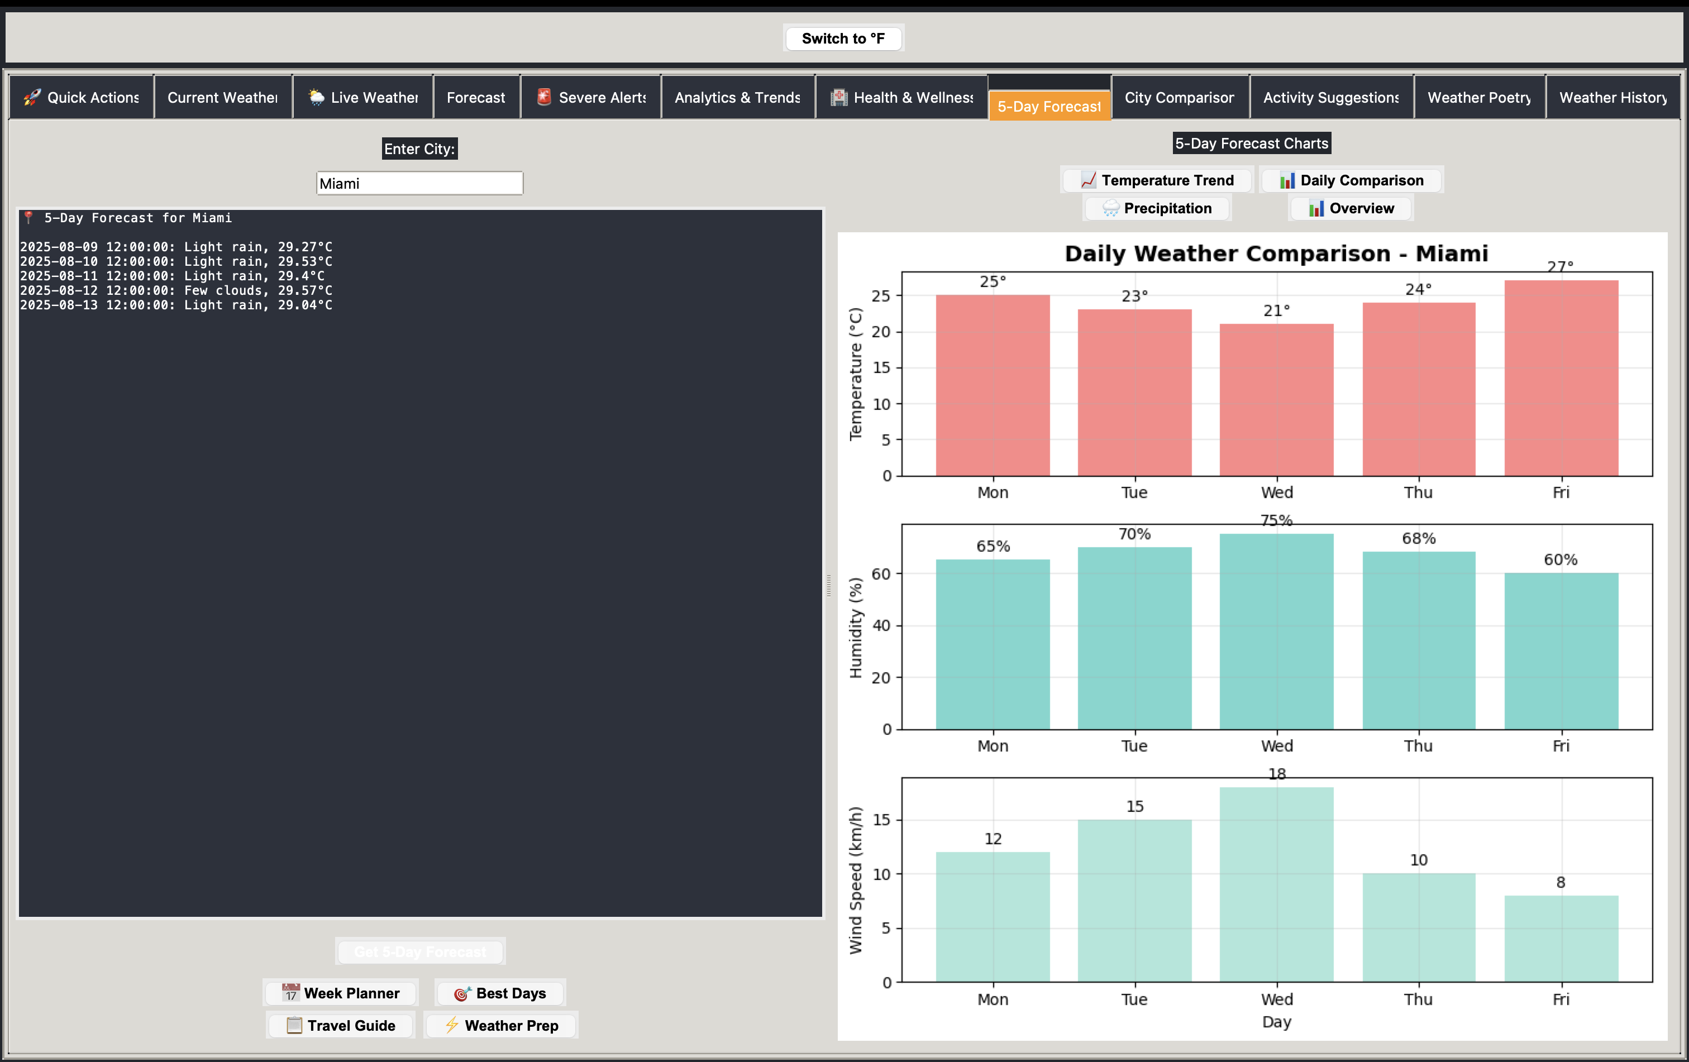
Health & Wellness

Slide 10
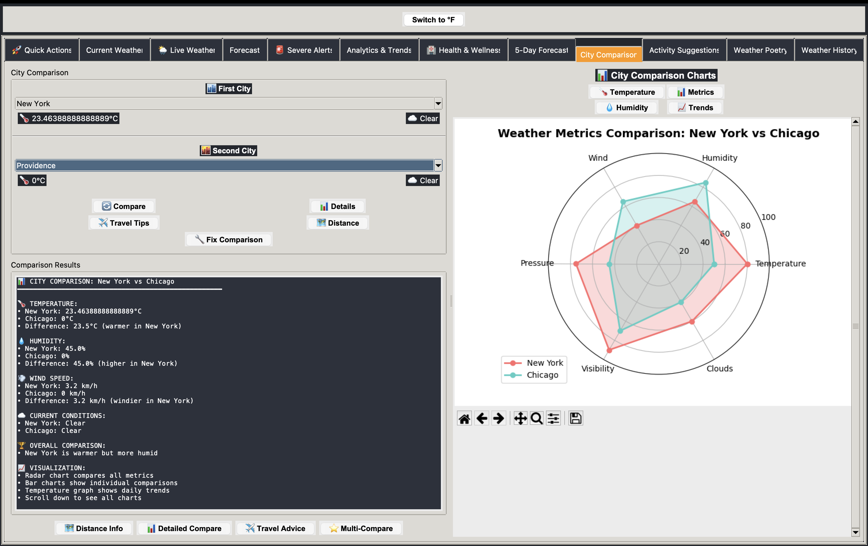
Activity Suggestions

Slide 11
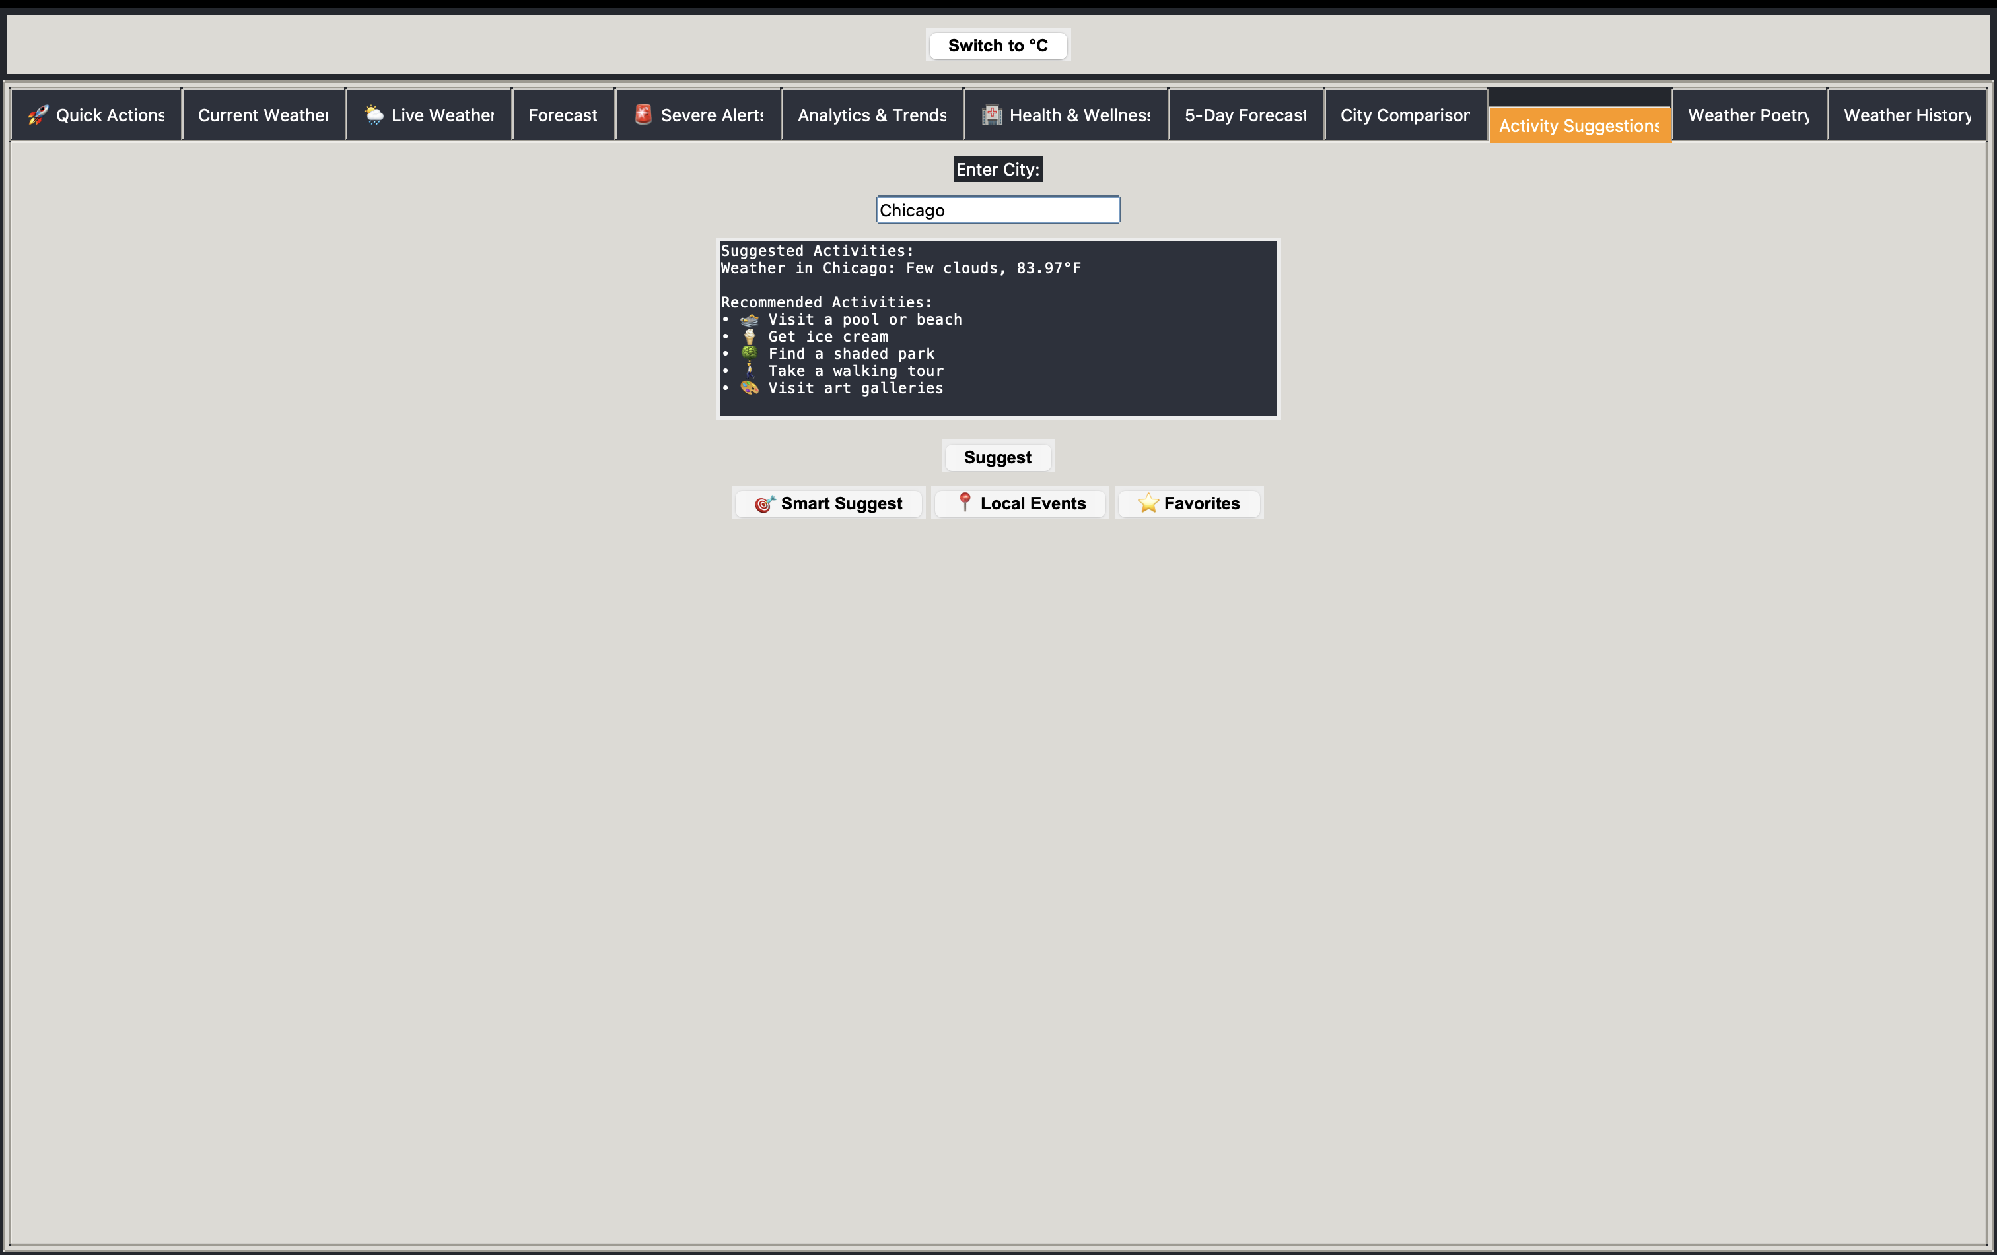
Weather Poetry

Slide 12
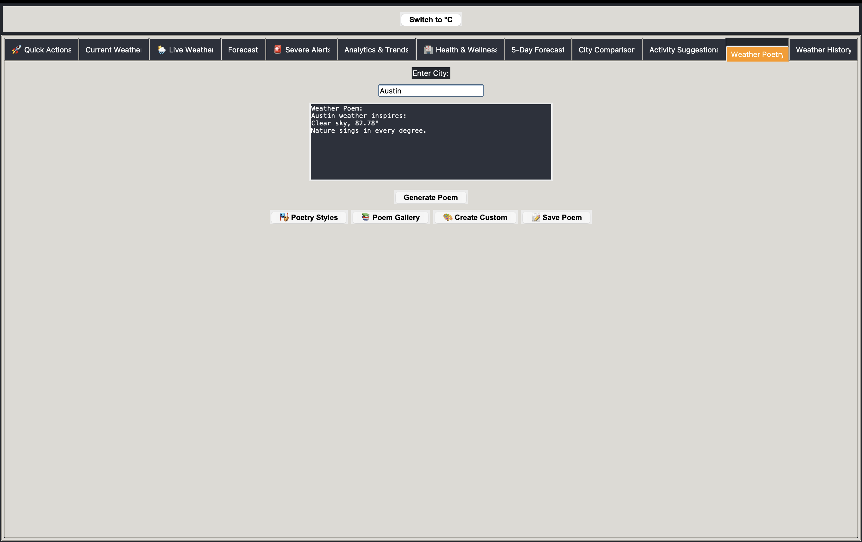
Weather History

Slide 13
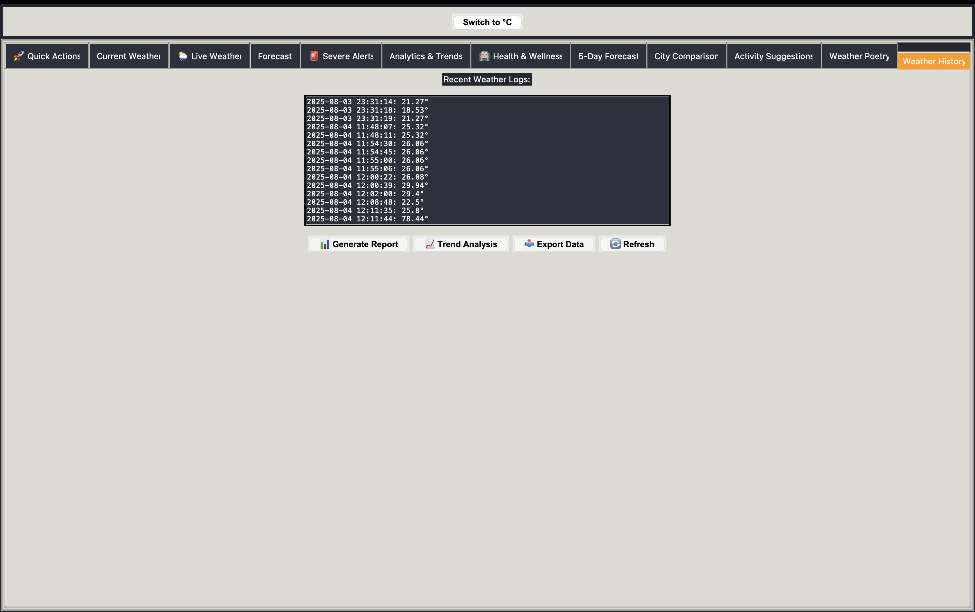
Settings

Slide 14
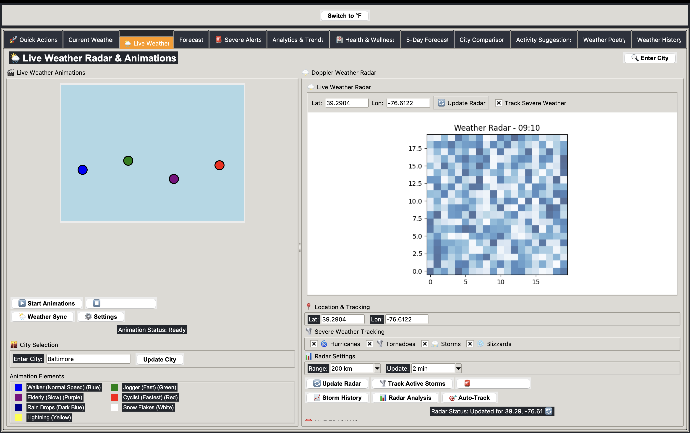
Extra Feature

